Slide 1

Data Analytics Project Portfolio
Ronda Austin
June 2024

Slide 2
Projects
GameCo Online Video Game Service pg. 4
Preparing for Influenza Season: Medical Staffing Needs pg. 7
Rockbuster Stealth, LLC pg. 12
Instacart Grocery Basket Analysis pg. 17
Pig E. Bank pg. 23
Gun Violence in US pg. 27

Slide 3
1. Game Co.
Online Video Game Service

Slide 4

1. GAMECO OBJECTIVE GameCo, a new video game company, seeks to use data to inform the development of new games. GameCo wants a descriptive analysis and insights of the video game data set, to understand how they fare in the market.
KEY QUESTIONS
Are certain types of games more popular than others?
What other publishers will likely be the main competitors in certain markets?
Have any games decreased or increased in popularity over time?
How have their sales figures varied between geographic regions over time?
DATA SET AND TOOLS USED
The dataset used is from the website VG Chartz. It covers historical sales of video games, selling over 10,000 copies.
http://www.vgchartz.com/
The tools used are EXCEL and POWERPOINT

Slide 5
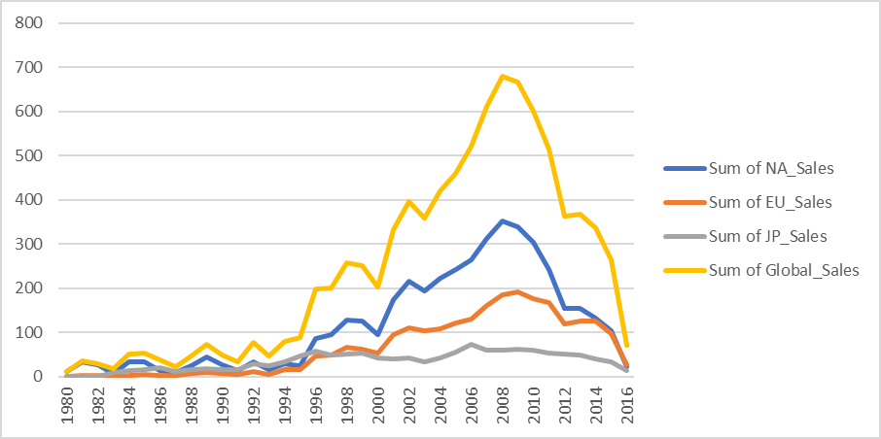
SKILLS:
Accessed the data using Excel.
Cleaned the dataset of incomplete data, and duplicates. Checked for data integrity, quality, and accuracy.
Created groups and pivot tables, and filtered data to analyze sales.
Insights developed and a descriptive analysis conducted.
Visualizations were created.
Results were presented
ANALYSIS:
Analyzed global sales, years 2007-2016, by Region, North America, Europe, and Japan.
Compared sales by region and movie genre.
Sum of game sales globally and by region, in millions of units sold, 1980-2016.

Slide 6
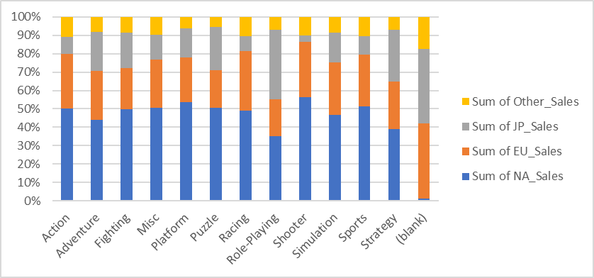
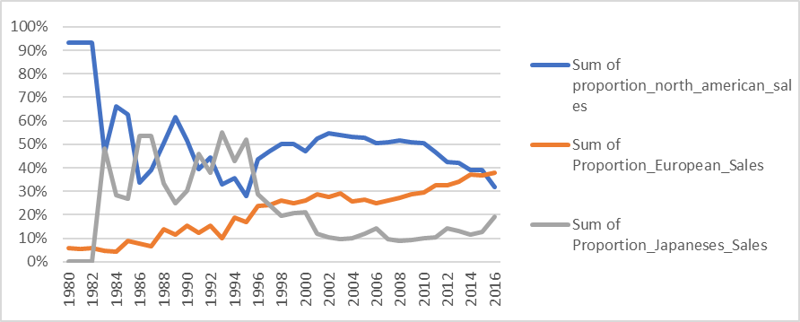
RESULTS
There is a large decline in North American Sales.
European sales have made slight increases.
Sales in Japan have consistently increased.
SALES BY GENRE/REGION
The top three game sales by genre for each region:
North America: Action, Sports, and Shooter games.
Europe: Action, Sports, and Shooter games.
Japan: Action, Sports, and Roleplaying games.
The percentage of games sales by game genre and region,
North America, Europe, and Japan.
PROJECT DELIVERABLES
Project Reflections document describing the data set used and the visualizations.
Power Point presentation of insights, results, and recommendations.
Task-1.10.pptx (live.com)
The sum of proportion of sales of games, by region, 1980-2016.

Slide 7
2.Preparing for Influenza Season
Medical Staffing Needs

Slide 8
2. PREPARING FOR INFLUENZA SEASON OBJECTIVE: To plan for the upcoming influenza season. The analysis will examine trends in influenza to assist a medical staffing agency in proactively planning for staffing of extra medical personnel in the United States. To proactively plan for to
SKILLS
In Excel, data cleaning, profiling, improvement of data quality and integrity.
Data integration – combining of data into one data set.
Conducting statistical analysis.
Creating charts and graphs with TABLEAU to present a story and analysis results.
DATA SETS AND TOOLS USED
Influenza deaths by geography
Source: CDC
Population data by geography, time, age, and gender Source: US Census Bureau
Counts of influenza laboratory test results by state (survey) Source: CDC (Fluview)
Survey of flu shot rates in children
Source: CDC
The tools used are EXCEL and TABLEAU

Slide 9
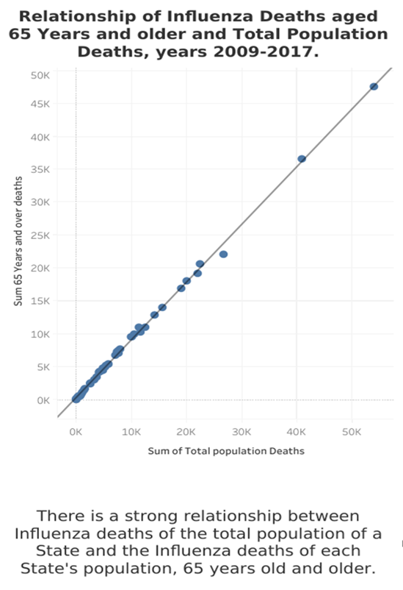
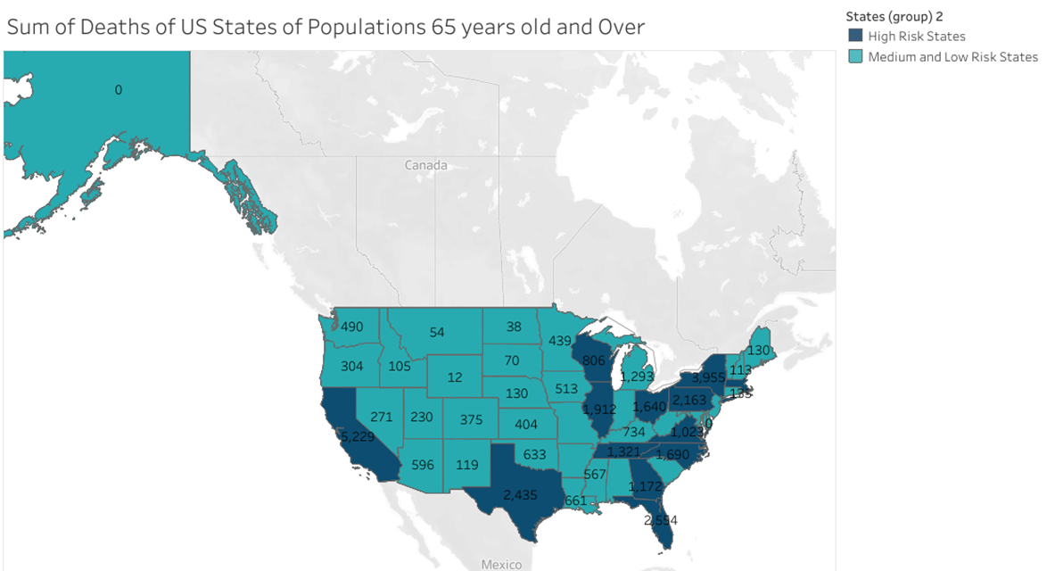
ANALYSIS
Visualizations were created to show the relationship between the total population deaths and deaths of persons 65 years old and over, and which states are at the highest influenza risk.
The States with the highest risk of influenza are California, new York, Texas, Pennsylvania, Florida, Illinois, Ohio, North Carolina, Michigan, Georgia, and Virginia.

Slide 10
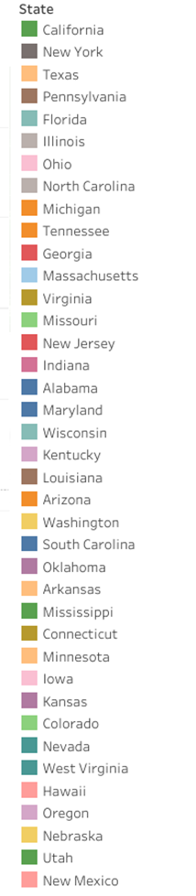
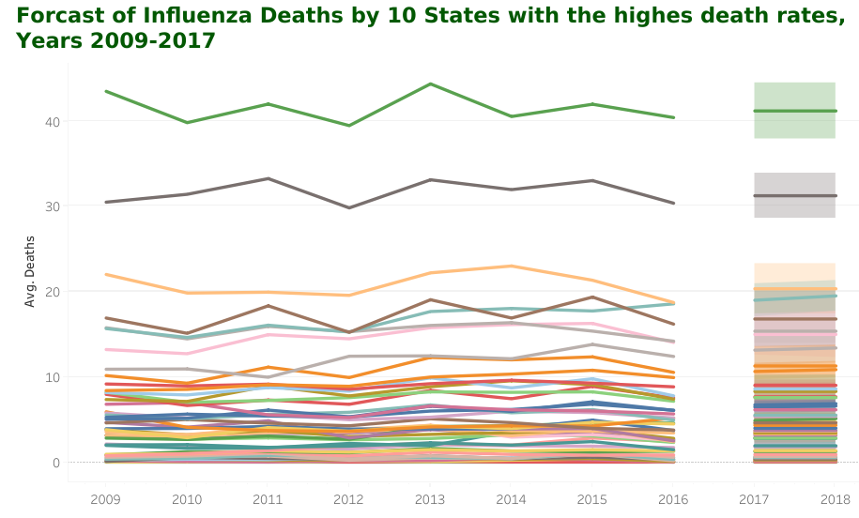
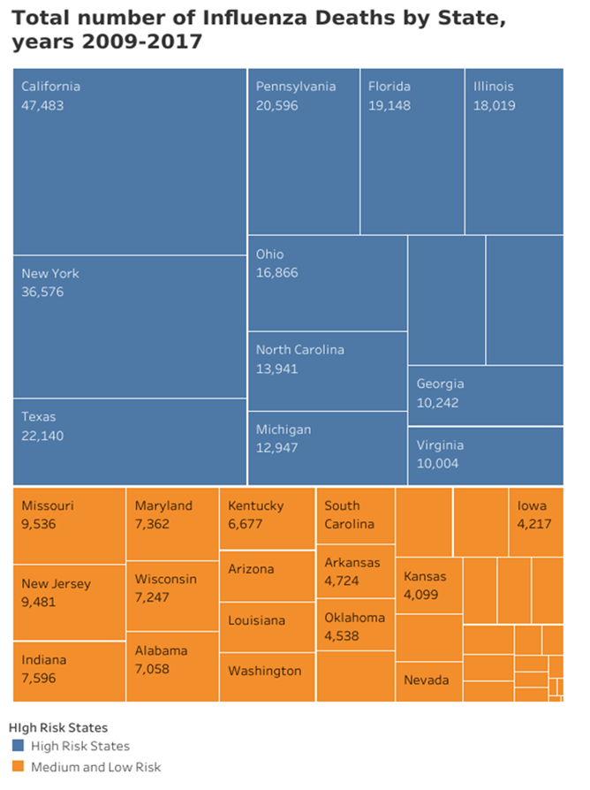
ANALYSIS
It is forecasted that California, New York, Texas, Pennsylvania, and Florida will have bad Influenza seasons.

Slide 11
Conclusions:
There is a strong relationship between populations of persons aged 65 years and older and deaths from influenza.
There are ten states which are at high risk from Influenza and are at high risk of people having complications, hospitalizations, and death.
The States at most risk are California, New York, Texas, Pennsylvania and Florida.
Recommendations:
Medical staff should be allocated to the US States at the highest risk of deaths are from the vulnerable group of 65 years of age and older.
It is advisable to follow CDC guidelines for Influenza prevention, including getting vaccinated, isolating if you are sick and washing your hands often.
Project Deliverables
Immersion 2.9 | Tableau Public
Medical Staffing Needs for Influenza Season (youtube.com)

Slide 12
3. Rockbuster Stealth, LLC

Slide 13
3. Rockbuster Stealth, LLC OBJECTIVE Rockbuster is a movie rental company. Facing heavy competition from online streaming services, Rockbuster’s team is planning to launch an online video rental service to stay competitive. An analysis is conducted to assist with the launch strategy.
KEY QUESTIONS
Which movies contributed to the most/least revenue gain?
What was the average rental duration for all videos?
Which countries are Rockbuster customers based in?
Where are customers with a high lifetime value based?
Do sales figures vary between geographic regions?
DATA SET AND TOOLS USED
The data set contains information about Rockbuster’s film inventory, customers, staff and payments.
The tools used are EXCEL, PostgreSQL/SQL, and TABLEAU.

Slide 14
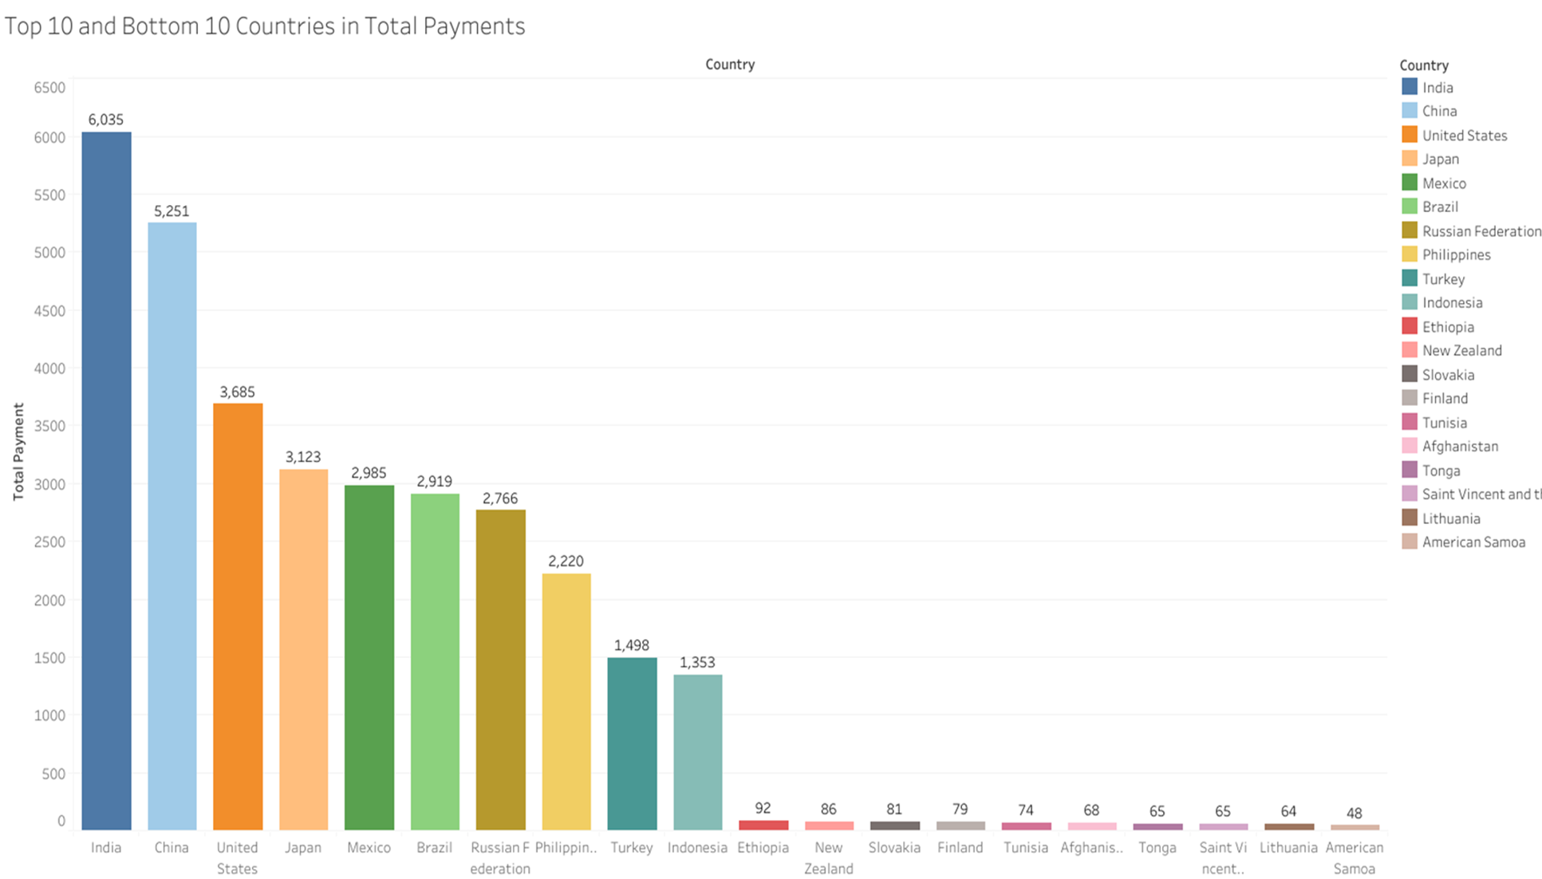
SKILLS:
SQL commands – database querying, ordering, limiting, grouping, sorting data.
Database migration, filtering data.
Summarizing and cleaning data, joining tables of data, performing subqueries.
Common table expressions.
Visualizations of SQL results using TABLEAU.
ANALYSIS:
Total Revenue 2006: $61,312.04
599 Customers
1000 Movies
17 Genres
Customers in 109 Countries
Most Popular Rating: PG-13
Average Rental Duration: 4.985 Days
The top countries for video rentals
include, India, China, United States,
Japan, and Mexico.

Slide 15
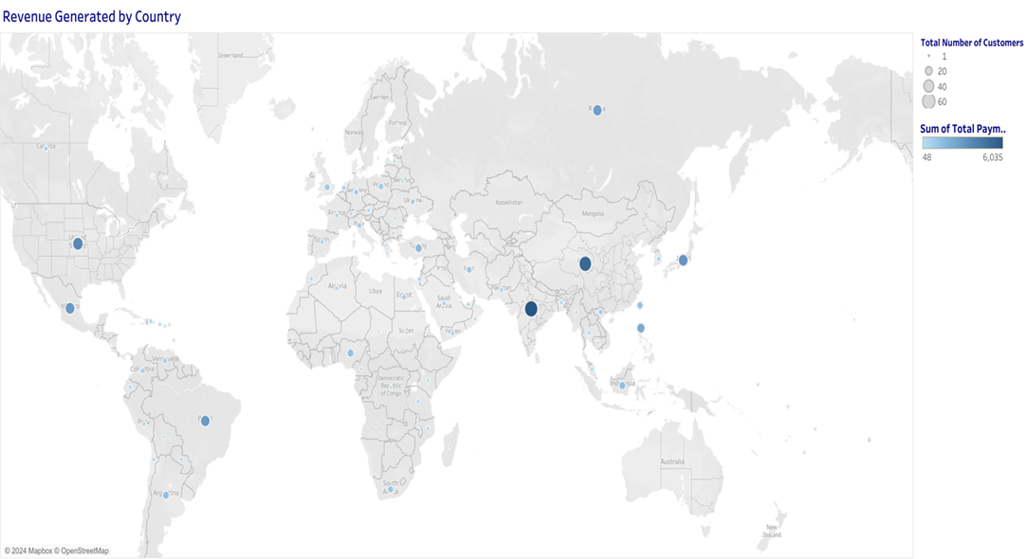
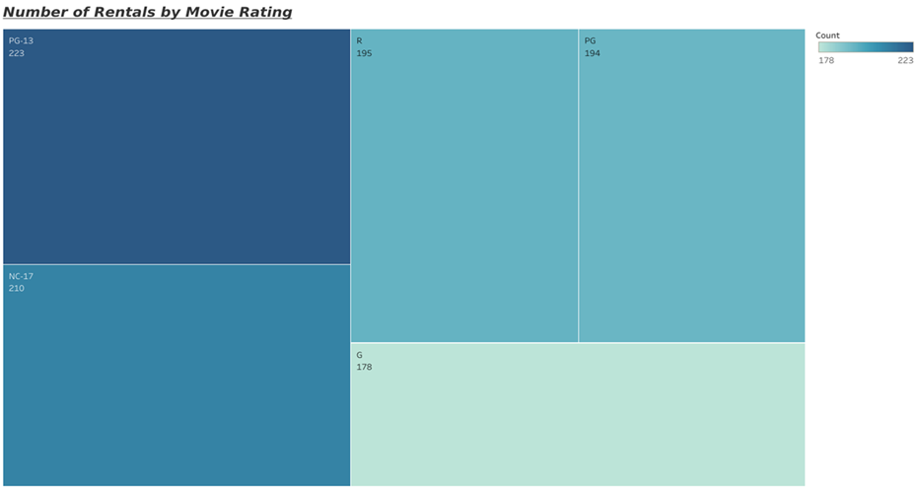
The ratings with the highest number of movie rentals are PG-13 and NC-17.
Rockbuster has customers in 109 countries, with the highest revenue generated by India, China, and USA.

Slide 16
Results & Conclusions
End licensing agreements for movies that do not generate adequate revenue.
Put further efforts into the top 10 countries that generate the most revenue.
Efforts should be focused heavily on the market in Asia, which has 7 of the highest generated revenues.
Expand the movie database, including movies with the highest ratings and in the languages of the top revenue generating countries.
Project Deliverables
Power Point Presentation: PPImmersion3.10 (3).pptx

Slide 17
4. Instacart Grocery Basket Analysis

Slide 18
4. Instacart Grocery Basket Analysis
OBJECTIVE
Instacart is an online grocery store operating through an app. Although they have good sales, they want to uncover information on their sales patterns. An analysis is done to derive insights and suggest strategies for better segmentation and have a targeted marketing strategy.
KEY QUESTIONS
What are the busiest days of the week and hours of the day?
Are there particular times of the day when people spend the most money?
Instacart has a lot of products with different price tags. Marketing and sales
want to use simpler price range groupings to help direct their efforts.
Are there certain types of products that are more popular than others? The
marketing and sales teams want to know which departments have the
highest frequency of product orders.
The marketing and sales teams are particularly interested in the different
types of customers in their system and how their ordering behaviors differ.
SKILLS
Jupyter and Python
Data wrangling, subsetting, and consistency checks
Combining and exporting data
Deriving new variables
Grouping and aggregating data
Python data visualizations
Final reporting in Excel
DATASETS
Career Foundry Customers Data set Instacart Data Sets:
Data Dictionary
Citation (required in your final report): “The Instacart Online Grocery Shopping Dataset 2017”, Accessed from www.instacart.com/datasets/grocery-shopping-2017 via Kaggle
TOOLS USED
EXCEL, Jupyter, Python, Tableau

Slide 19
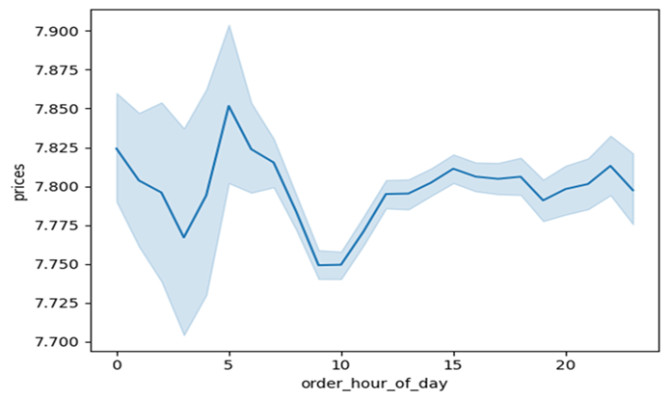
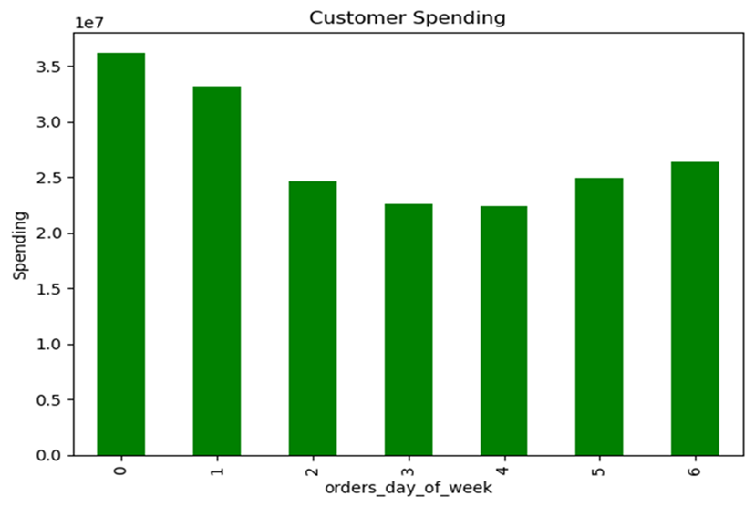
Customer Spending
The busiest days are Saturday, Sunday, and Friday.
Marketing efforts should be focused on Tuesdays and Wednesdays when orders were lowest.
The order frequency by hour of day, shows the most orders during the day between 10:00 am and 3:00pm. The most orders are placed at 10:00-11:00am.
Marketing efforts should entice shoppers to shop early before the day begins, or in the evening, especially on the weekends when time is better spent with family and friends.
Having a sale or discounts to make purchases on certain days/certain hours during the day, may allure shoppers.
The hours of the day with the most spent on orders are in the early morning, close to 5:00 am, midnight, and 10:00pm. ,
From 8:00 am until noon, there are low spending orders.
Advertise higher end/luxury products that have coupons or are on sale during low spending hours.

Slide 20
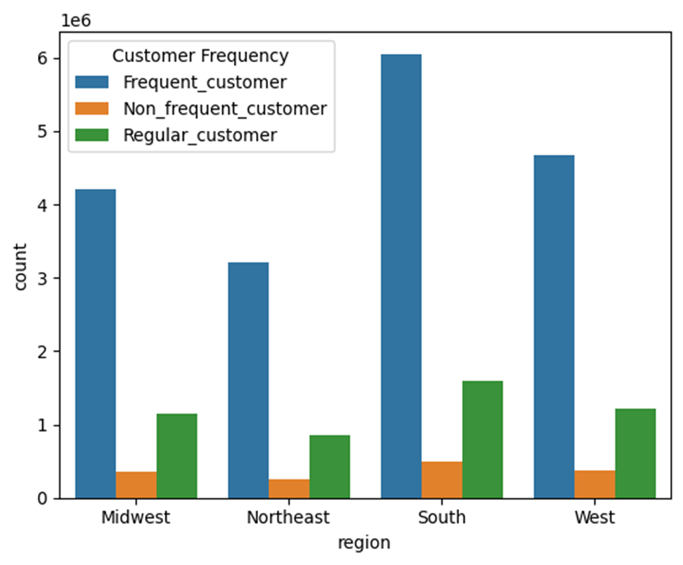
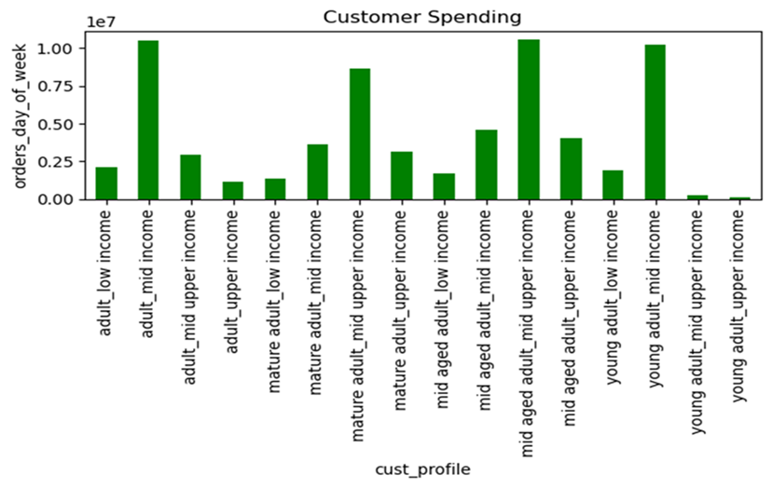
CUSTOMER SPENDING
The customers were profiled by age and income level. The groups who order/spend frequently are young adult/middle income, adult/middle income, middle-aged adult/ middle-upper income, and mature adult/mid-upper income.
The lower income groups have much lower orders suggesting prices and delivery fees are too costly and/ or there is a general lack of knowledge of the company.
Advertising through social media and social platforms can help reach a younger audience.
The upper income groups may feel that the website is more time consuming than they like or that there is not adequate customer service.
Providing an accessible, logical website and great customer service, can help facilitate customer's needs.
CUSTOMER FREQUENCY
The count of customer frequency is divided into three groups: Frequent, Non-Frequent and Regular.
The south has the most orders for all categories, followed by the West.
The Midwest and Northeast may need some additional marketing or may have lower order frequency from smaller overall consumer populations.
Circulars in mailboxes, advertising at restaurants, events, and social media advertising can all help propagate Instacart's information to rural parts of America.

Slide 21
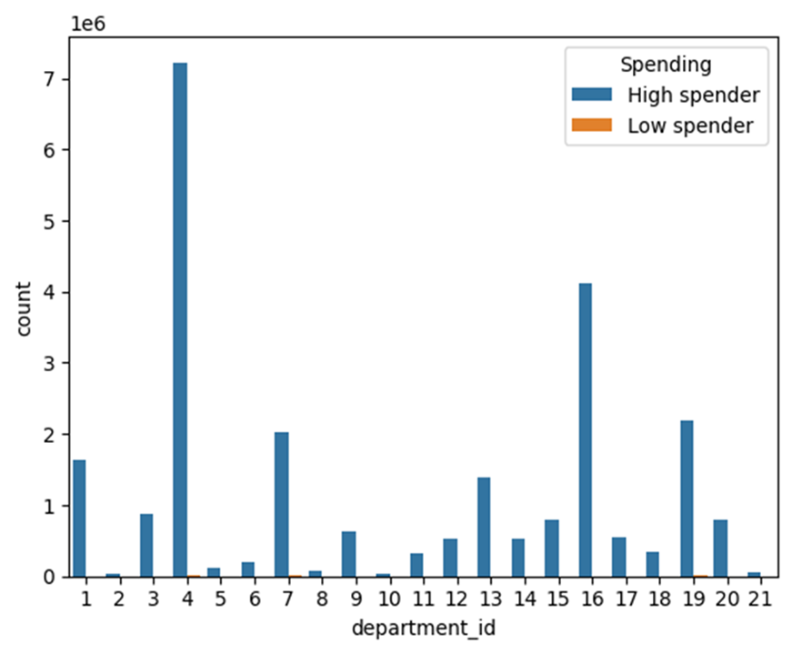
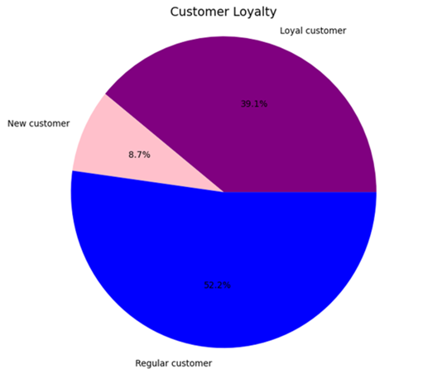
ANALYSIS
department_id | High spender | Low spender
4 produce | 7224947 | 2144
16 dairy eggs | 4119587 | 901
19 snacks | 2182665 | 4456
7 beverages | 2033407 | 3040
1 frozen | 1627352 | 262
13 pantry | 1385092 | 283
3 bakery | 883175 | 155
15 canned goods | 787662 | 128
20 deli | 782815 | 196
9 dry goods pasta | 633676 | 49
17 household | 539021 | 328
14 breakfast | 524694 | 251
12 meat seafood | 523863 | 27
18 babies | 335938 | 9
11 personal care | 328374 | 106
6 international | 197889 | 11
5 alcohol | 107864 | 108
8 pets | 72103 | 8
21 missing | 57562 | 5
10 bulk | 27523 | 35
2 other | 27140 | 26
LOYALTY
Loyalty of customers is divided into three groups: New Customer, Regular Customer, and Loyal Customer.
New customers have 10 or fewer orders, making up 8.7% of the customer base.
Regular customers have over 10 but 40 or fewer orders, making up 52.2% of the customer base.
Loyal customers have over 40 orders, making up 39.1% of the customer base.
Departments with the highest frequency of product orders are produce, dairy/eggs, snacks, beverages, frozen, and pantry.
Provide marketing, promoting different products in the departments with lower sales in the sections where
there is high spending.
Place coupons in high spending departments, for products in departments that have low spending numbers.

Slide 22
A program to encourage loyalty could encourage participates to sign up and shop more with Instacart. Bonus points, coupons for money off products, free shipping or delivery for first time buyers, can all contribute to loyalty. Access to exclusive deals just for Loyalty members, will also encourage frequent shopping.
Provide marketing, promoting different products in the departments with lower sales, in the sections where there is high spending. Place coupons in high spending departments, for products in departments that have low spending numbers.
Advertising through social media and social platforms can help reach a younger audience.
The upper income groups may feel that the website is more time consuming than they like or that there is not adequate customer service. Providing an accessible, logical website and great customer service, can help facilitate customer's needs.
Conclusions

Slide 23
5. Pig E. Bank

Slide 24
5. Pig E. Bank
OBJECTIVE
Pig E. Bank is a global bank. They are looking for analytical support to its
anti-money-laundering compliance department, to assess client and transaction
banking risk and to build models to assist running the compliance program more efficiently.
Key Points Encountered
The characteristics of big data, how data analysts use big data, and the challenges of extracting knowledge from big data
The impact of data bias and ethics on how data is used, shared, collected, and protected The fundamentals of data mining, including techniques for data mining and how it drives decision-making
Predictive analysis and models such as linear regression
Time-series analysis and time-series forecasting
The basics of GitHub and how you can use it to refine your skills, collaborate with colleagues, and display a portfolio of work
What to include in your portfolio when applying for jobs.
SKILLS
Understanding big data, data bias, security and privacy.
Data mining, predictive analysis, time series analysis and forecasting.
Understanding GitHub
Preparation of a Data Analytics Portfolio.
DATASETS
5.4-PigEBank-Client-Data set (1).xlsx
TOOLS USED
EXCEL, PowerPoint and GitHub

Slide 25

Decision Tree
Customer retention is heavily dependent on whether a customer is an active member.

Slide 26
RAustin2112 (github.com)
Results
Poor to fair credit scores make up 61.27% of the customers.
Female customers that left make up 59.31%.
69.11% of customers who left were between the ages of 35-54.
27.43% of customers maintained a $0.00 account balance.
The tenure of the customers who left was 1-2 years, at a total of 27.95%.
7.35% of customers had an estimated salary of $0-9,999 and 110,000-119,999, respectively.
70.10% of customers are inactive members.
Recommendations
Provide information on existing and new products and services to customers and advertise these to potential customers.
Contact inactive customers to find reasons for inactivity.
Provide incentives to inactive customers to remain active with the bank.
Offer banking benefits to retain loyal customers.
Create further analysis on customer’s bank needs to provide better services.
Project Deliverable
RAustin2112 (github.com)

Slide 27
6. Gun Violence in US
Online Video Game Service

Slide 28
6. Gun Violence in US
Are you safe in the US?
The analysis is from records of gun violence January 2013- March 2018. There are constant debates on the reasons and causes of gun violence and gun control. Where is the United States are you safe and where are the danger areas?
TOOLS USED
EXCEL, Tableau and GitHub
SKILLS
Sourcing Data
Analysis in Python
Results presented in a Tableau Storyboard
Completion of a Data Analytics Portfolio.
DATASETS
Gun Violence Data (kaggle.com)
Quandl – Federal Reserve Economic Data: Unemployment Rates
Gun Violence in US(2) | Tableau Public

Slide 29
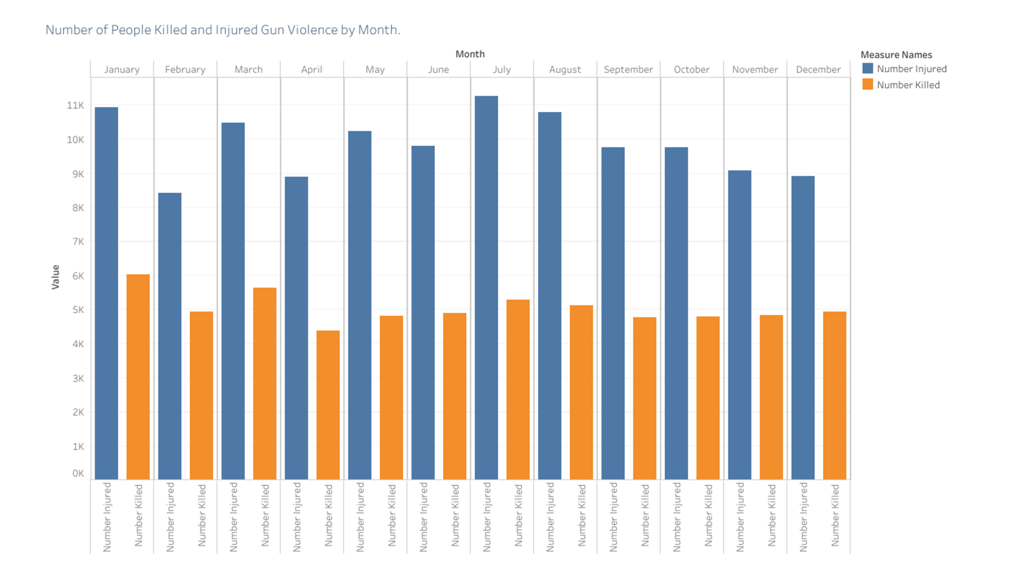
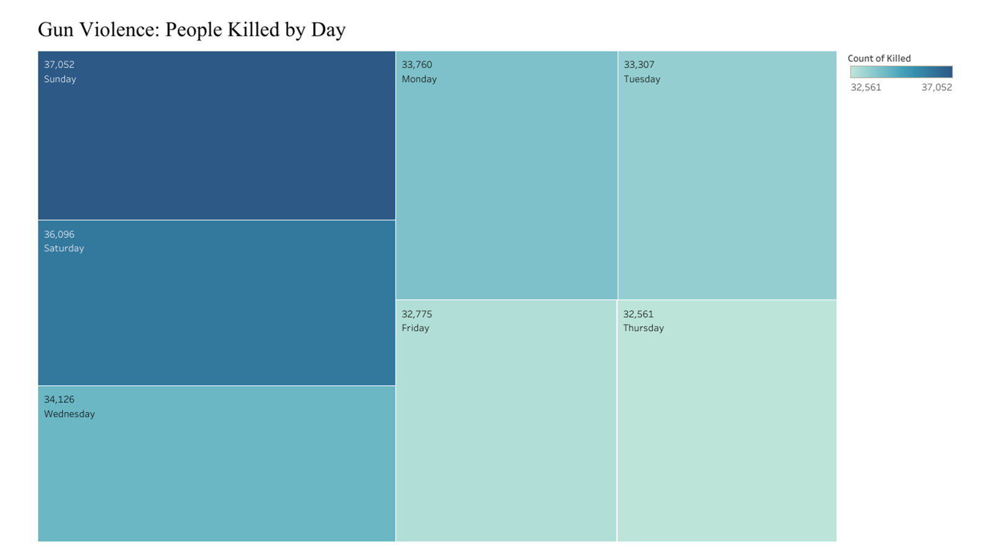
Are you safe?
The times you are in most danger for gun violence are on Sundays and Saturdays. This is when people are gathered for events. Being in a crowd definitely raises risk.
The most dangerous months with the most killed or injured are January, March, July, and August.
Analysis

Slide 30
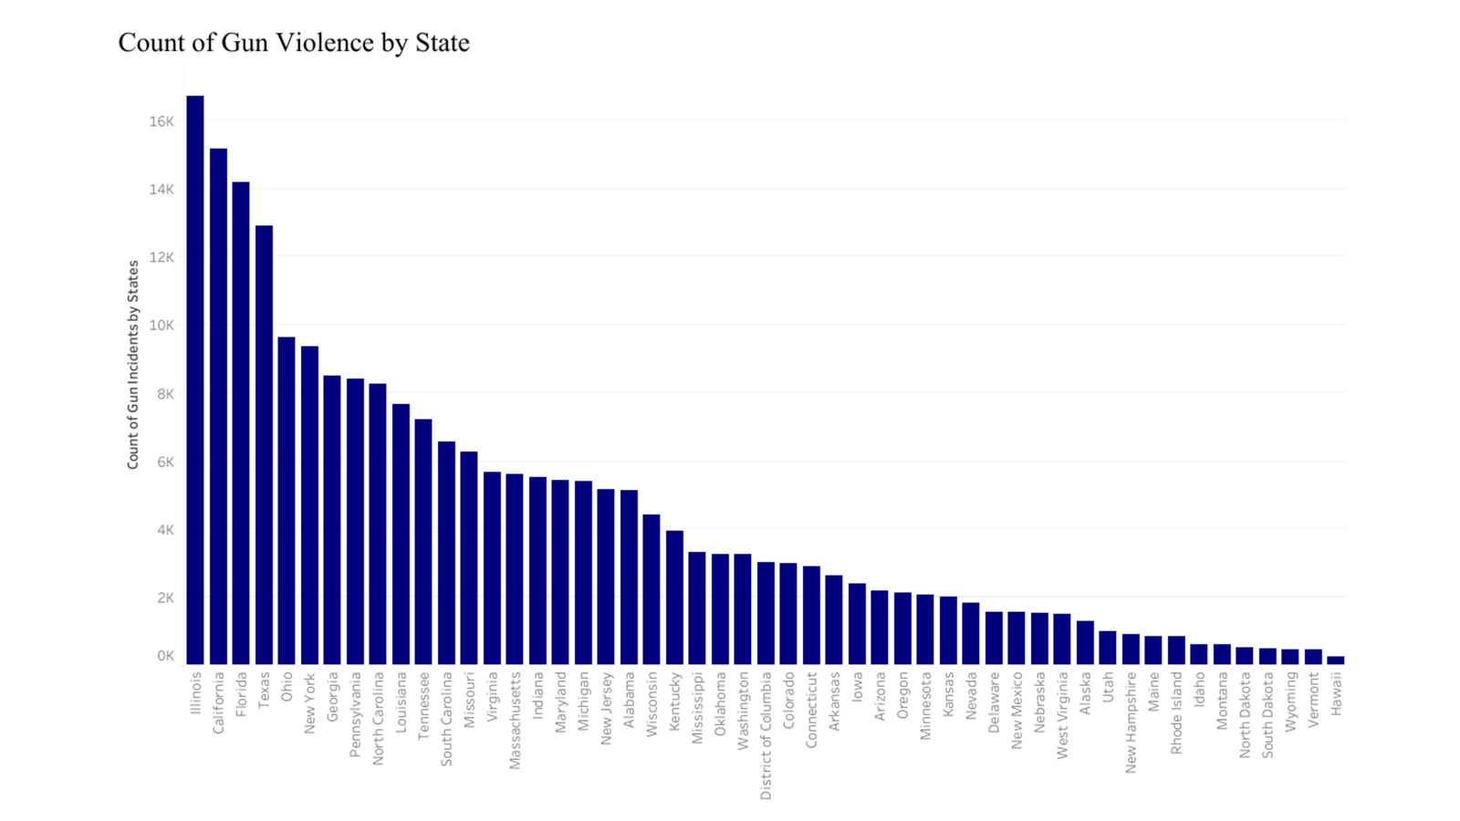
Are you safe?
The places you are in most danger for gun violence are
Illinois, California, Florida, Texas, Ohio, and New York

Slide 31
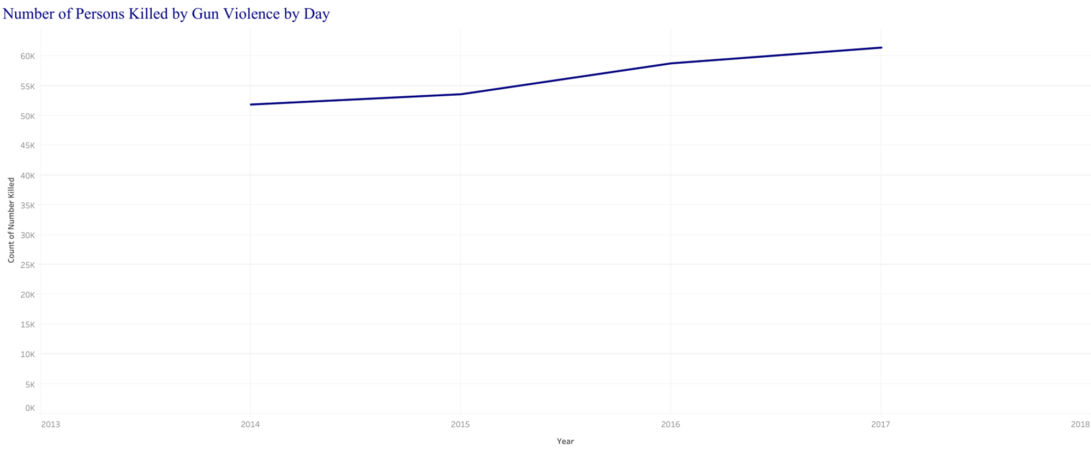
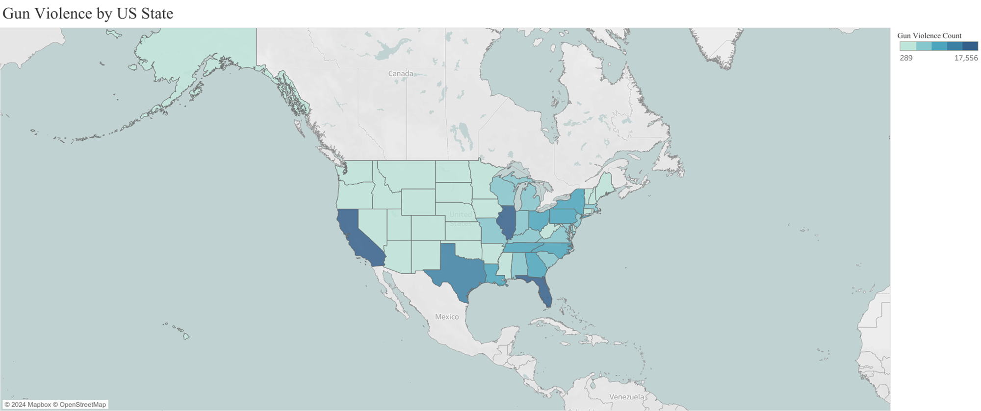
Conclusions
ANALYSIS
The amount of gun violence in the US is rising every year.
The States that are at the highest risk of gun violence are Califormia, Florida, Texas, Ohio, New York, Georgia, and Pennsylvania.
The highest risk months and days of the week are January, March, July and August, Sundays and Saturdays.
The States with large cities are at higher risk for gun violence danger.
Large populations of people, for example on the east coast of US, contribute to more guns and violence.
Recommendations:
The solutions for gun violence are complex.
Social and economic issues, those who are struggling financially, can be a contributing factor.
Access to guns should be reduced for individuals with a history of violence and persons with mental illness.
Education on gun safety is crucial.
Training and adequate gun licensing for gun owners
could help prevent US gun violence.

Slide 32
Thank You

